Slide 1
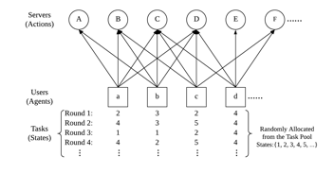
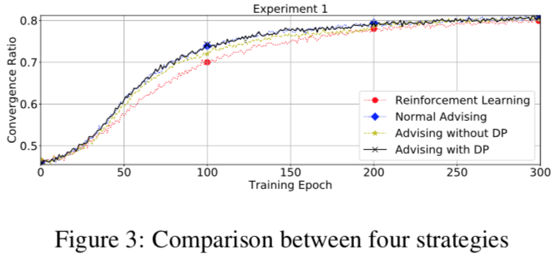
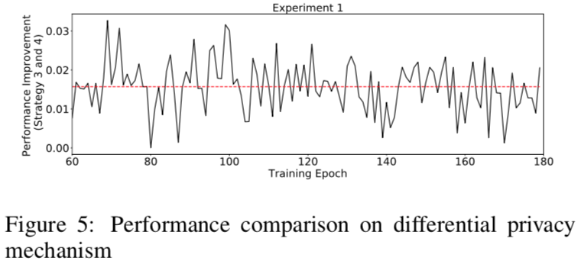
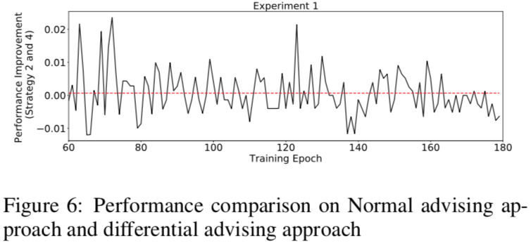
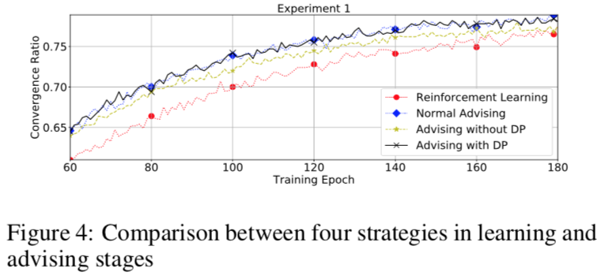
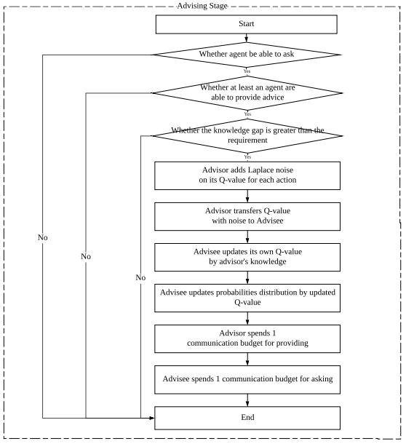
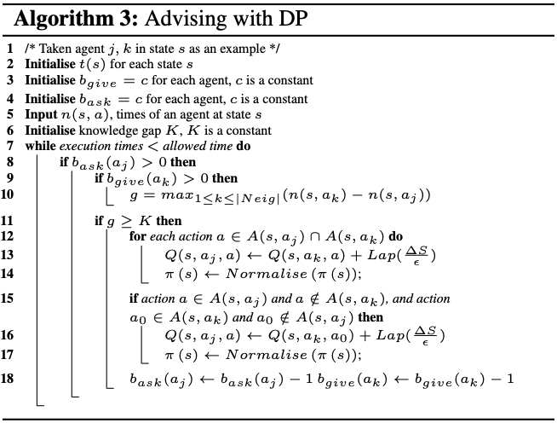

Simultaneously Reinforcement learning and Advising
via Differential Privacy
Sheng Shen, Tianqing Zhu, Dayong Ye, Mengmeng Yang,
Tingting Liao & Wanlei Zhou
Abstract
Materials
Results
Conclusion
Advising plays a significant role in improving multi-agent reinforcement learning performance. It is one of the approaches which enable agents to ask and provide advice between each other. Existing multi-agent advising approaches have a limitation that all the agents in a system are assumed learning in a completely same environment and performing a same goal, which means all agents have the same available actions. However, in the real-world, although multiple agents are sharing the same system, they may have similar available actions but not completely same. To overcome this limitation, this paper firstly propose a novel differentially private agent advising approach in reinforcement learning. Our approach employs the Laplace mechanism to add noise on the Q-value which is learning experience, conveyed from the adviser to the advisee. By using the promise of differential privacy technique, our proposed approach can mitigate the impacts on the difference of actions between the teacher and the student. The application of differential privacy in this approach improve the performance of reinforcement learning by executing advising stages more effectively and efficiently with flexible agents' situation. The experimental results demonstrate the effectiveness of the proposed approach by the comparison between comprehensive strategies.
In this example, there are over
four users, a,b,c,d, ··· . These users
can be considered as agents
participating in reinforcement
learning process. There are also
some tasks named with numbers
which can be perceived as states.
All agents form the set of states, S.
In each round, each agent is allocated to a random task from the set of tasks { 1 , 2 , 3 , 4 , ···} , this step can be considered that each agent is at one state of the set of available states in each round of learning process. Servers A,B,C,D, ···, are executors to solve agents’ tasks, which are considered as actions in this scenario. All servers com- pose the set of actions, A. Severs are defined to be able to solve all tasks but with different abilities on different tasks.
We proposed a new differential advising approach for simultaneously multi-agent reinforcement learning in this paper. It is also the first work to incorporate the differential privacy on advising framework to think about the situation of agents with not completely same available actions. The experimental results demonstrate the adequate performance of our approach which can accelerate learning speed by extending the applicable field of advising among agents with actions differing in one.
In this section, we demonstrates our results of the experiment. In Figure 3 and Figure 4, the x-axis represents execution times for each strategy, and the y-axis means the ratio of the sum of actual reward gained by all agents and the sum of theoretical maximum reward that all agents can obtain. The increase of the ratio is the speed of convergence which represents the learning speed. We set all agents have the same number of available actions for each strategy, which means all users can access all servers in Regular learning and Normal advising strategies, and all users can access the same number of servers but differing in one actions, to guarantee all agents can advice others in the third and fourth strategies. In Figure 3, all strategies start from about 45% and converge at around 80% after 300 training epochs, which proves the reliability of experiment that they are learning in the completely same system.
Our approach, advising with differential privacy, and the second strategy, normal advising, have the a high degree of similarity, and better in learning speed than the other two strategies, which is clearly shown in Figure 4. It shows the important learning stage with the effect of advising in training epochs from 60 to 180. Our approach almost overlap normal advising with the highest learning speed, which means in the same system, our approach can perform well as normal advising though agents’ actions are differing in one record, clearly shown in Figure 6. The Figure 6 shows the performance comparison on Normal advising approach and our proposed approach. The red line is average percentage of performance comparison. It closes to 0 and proves that two approaches are equivalent in both environments with same actions and different actions for advisors and advisees. Figure 5 proves the effectiveness of differential privacy mechanism. In strategy 3, the method that advisor directly transfer its different action’s knowledge to advisee’s action can cause misadvising for that action, which negatively impact on the advising efﬁciency and learning speed. In Figure 5, differential privacy mechanism can improve the performance 1.5% with the weight 1/8 . In other words, it can improve around 10% in total performance. Without doubt, the experimental results show the feasibility and accuracy of our approach.
Methodology
The process of advising stage is shown in Figure 2. Firstly, an agent j decides whether it is able to ask for advice in one learning step by checking its ask budget bask(aj) > 0. If agent aj is able to ask for advice, it also needs to check whether there is one neighbouring agent can provide advise by checking its giving budget bgive and knowledge gap. If budget bgive(ak) > 0 and knowledge gap g > K, K is a pre-determined constant which means the minimum requirement of knowledge gap to execute advising stage. Assume that agent ak is able to ask agent aj for advice, it sends an advice request message which is the current state of agent aj, to agent ai. Once agent ai receives this request message, agent ai needs to directly send its advice back to agent aj. The advice includes agent ai’s knowledge and learning experience, Q-value, which assists agent aj to adjust its own Q-value and make further decision on the actions.
The Algorithm 3 shows the algorithm of advising strategy in our proposed approach. The Laplace noise, Lap(∆S/$ε$) is added on the advisor’s Q-value in Line 13 and Line 15. ∆S is the sensitivity of the maximum reward. As the current reward has a direct impact on the selection probability. The sensitivity ∆S is determined by the maximum reward. Advisee accept advisor’s Q-value with noisy on actions which are owned by both the advisor and the advisee, with discount rate. According to Deﬁnition 1, the application of differential privacy here is to mitigate the impact of the difference on one action. Advisee can accept the Q-value for the action differed in advisor’s. The process is considered as that the advisor obtains a extra reward for each action in this state in advising stage, and then accelerate its learning speed.
Recommendations
Introduction
This paper should be improved with following further work:
The convergence of Q-learning
The communication budget
Differential privacy model, i.e. PMW, exponential noise
…
advising is limited due to the difference of agents' environments. The difference of their environments can lead to the difference of their available actions. In real-world, it's commonly that agents have different available choices even if they are at the same states. Because current advising framework can only focus on the situation that all agents have and same action options, existing advising frameworks could not be applied in the above proposed environment. Therefore, it is crucial to solve the problem on advising among agents with different available actions.
During the research stage of related work on advising and knowledge transfer, we find that few existing solutions contributing to this problem and little previous work have thought about knowledge transfer between two agents with different available actions. The challenge is how to transfer the knowledge on the actions which are different in advisor and advisee's. Therefore, in this paper, we find that differential privacy mechanism can address this problem with the property of randomisation. We consider all agents' available actions and their knowledge related to these actions at current step in each state as individual datasets. The two datasets can be considered as neighbouring datasets in differential privacy property, and be processed by adding Laplace noise. It can improve the accelerate learning by expanding the applicable field of advising and increase the probability of the occurrence of advising. The differential privacy property in our work is to guarantee that the knowledge embodied in a action set for can still be used to give advise if the two actions differ in, at most, one record.
Acknowledgements
Thanks for Tianqing Zhu and Dayong Ye’s idea and guidance. Thanks for Mengmeng Yang’s guidance on differential privacy mechanism. Thanks for Tingting Liao’s help on experimental design and coding work.

